Slide 1
Lists, Bookmarks & Tables

Slide 2
Topics
Lists
https://www.w3schools.com/html/html_lists.asp
Bookmarks:
https://www.w3schools.com/html/html_links.asp
Tables
https://www.w3schools.com/html/html_tables.asp

Slide 3
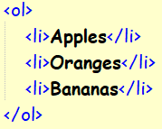
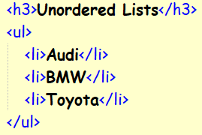
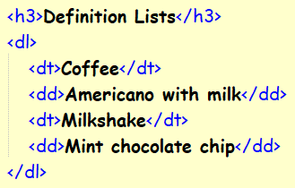
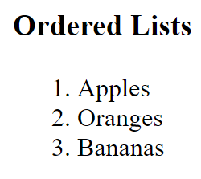
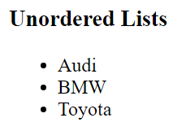
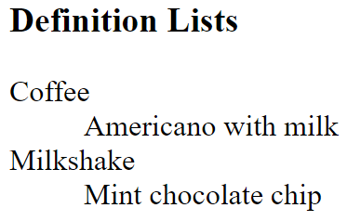
Lists
Unordered List
Definition List
Ordered List

Slide 4
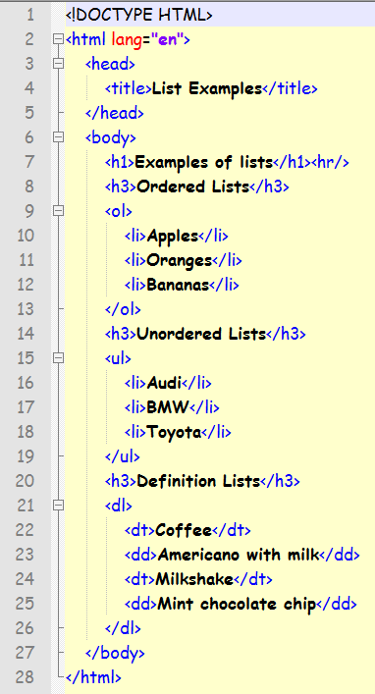
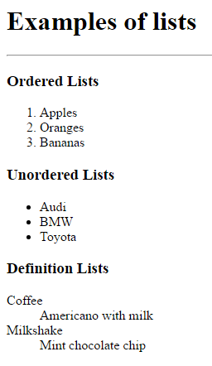

Slide 5
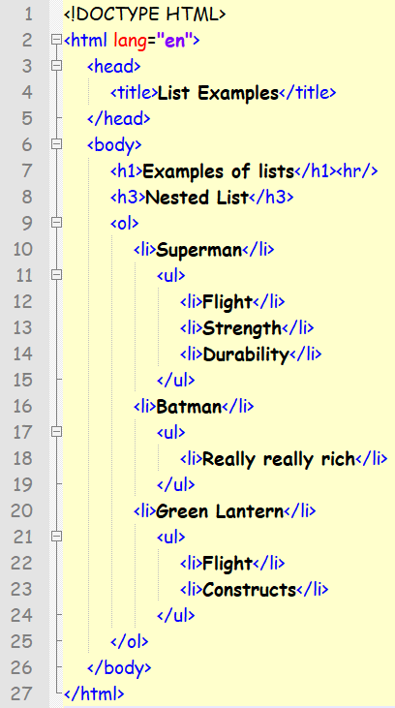
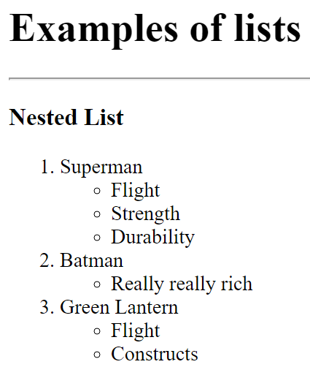
Nested Lists

Slide 6
Bookmarks
HTML bookmarks are used to allow readers to jump to specific parts of a Web page.
Bookmarks can be useful if your webpage is very long.
To make a bookmark, you must first create the bookmark, and then add a link to it.
When the link is clicked, the page will scroll to the location with the bookmark.

Slide 7
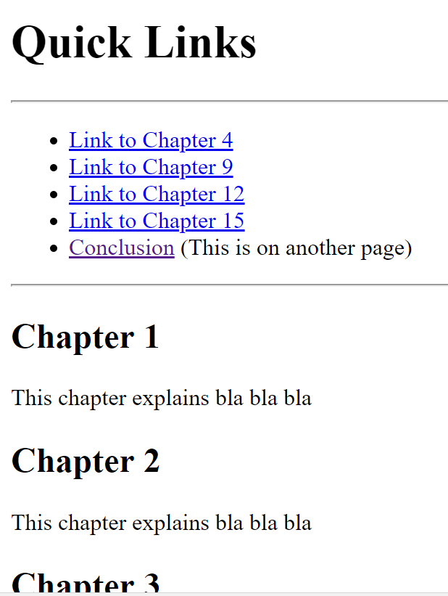
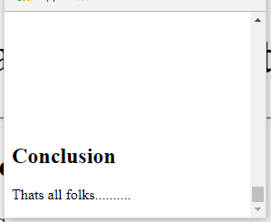

Slide 8
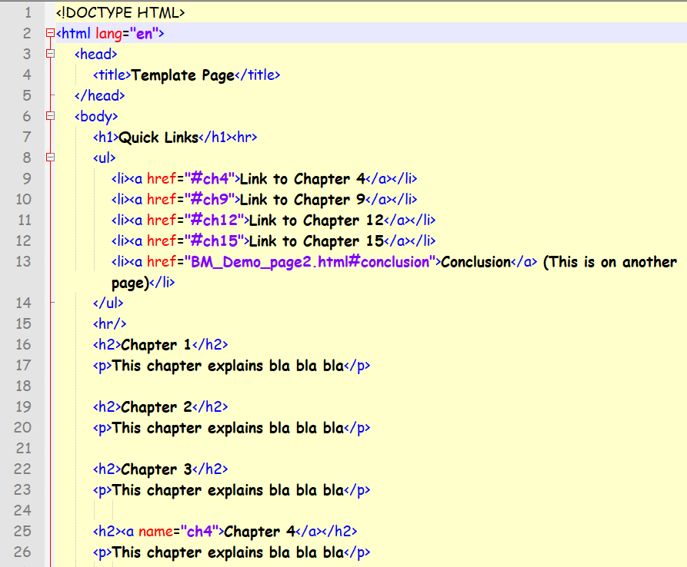
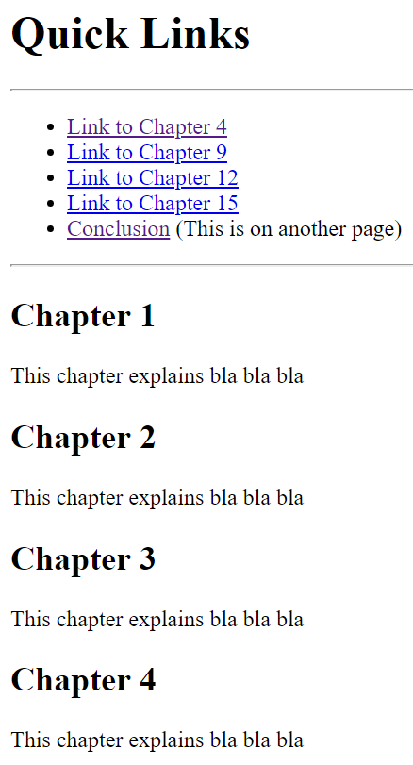

Slide 9
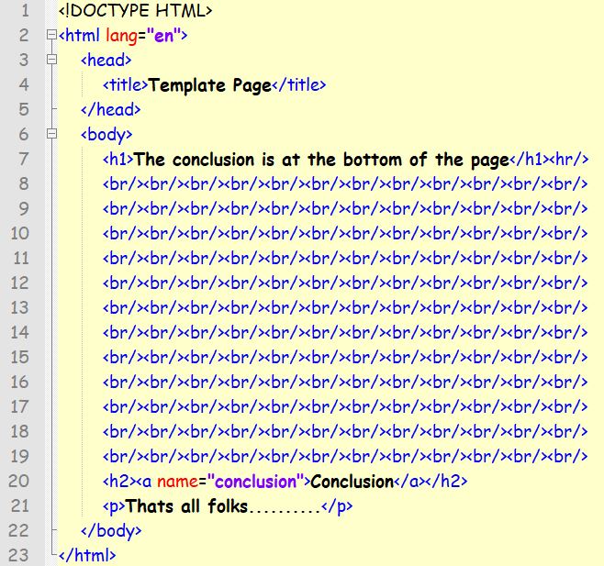

Slide 10
Download the sample files available on Moodle

Slide 11
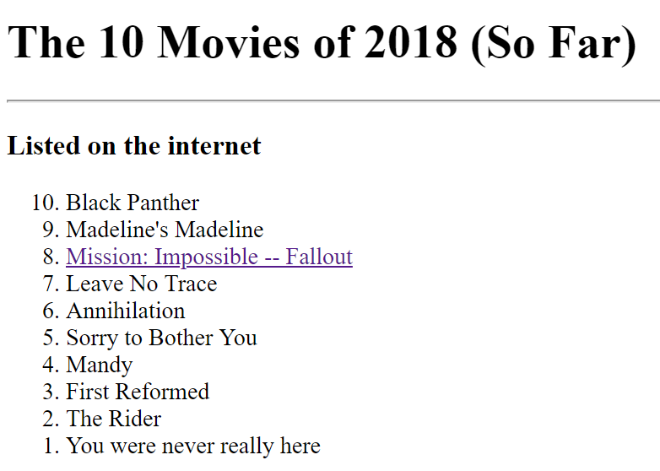
Question
Download and extract the root folder and rename it as Week3
Create a new file from the template and name it Top10Movies.html
Create the following list
Use the W3Schools to find out how to reverse the order of the list.
Link the movie in position 8 to its page on the IMDB

Slide 12
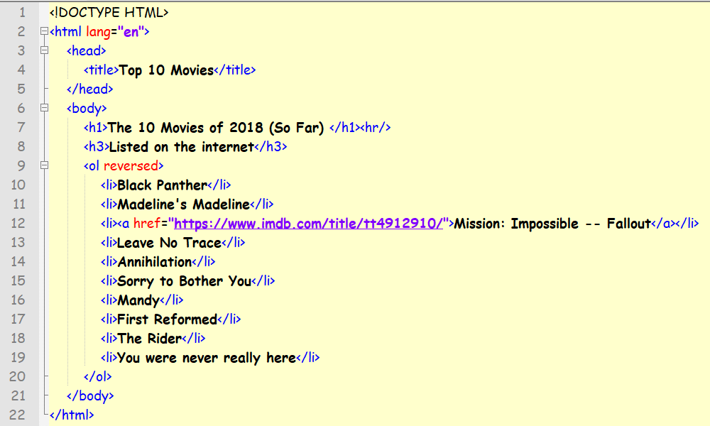

Slide 13
Tables

Slide 14
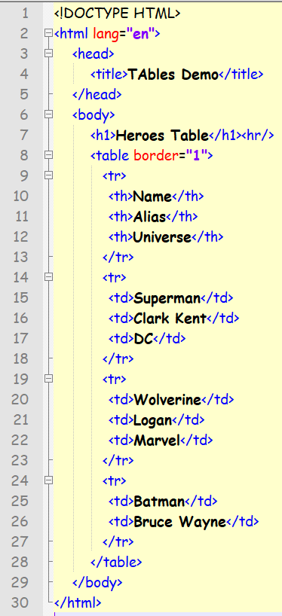
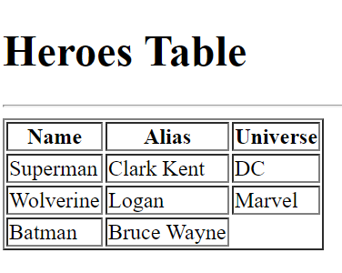

Slide 15
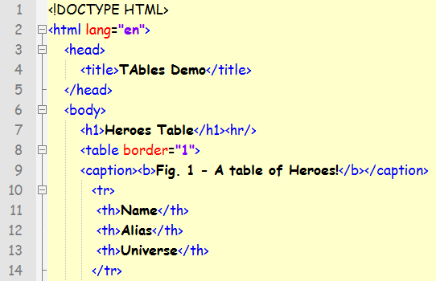
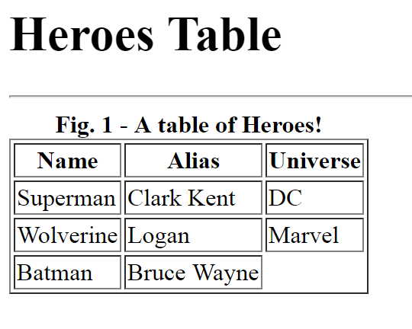
Table Captions

Slide 16
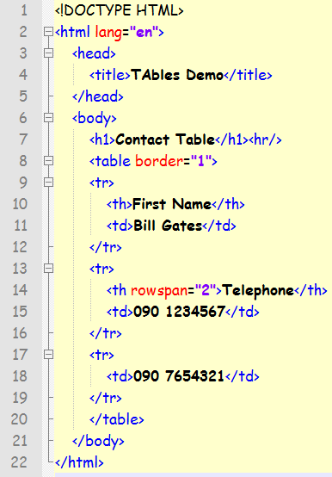
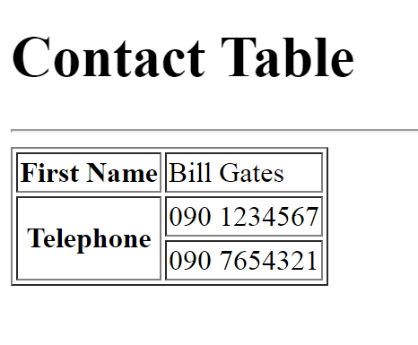
Spanning Rows

Slide 17
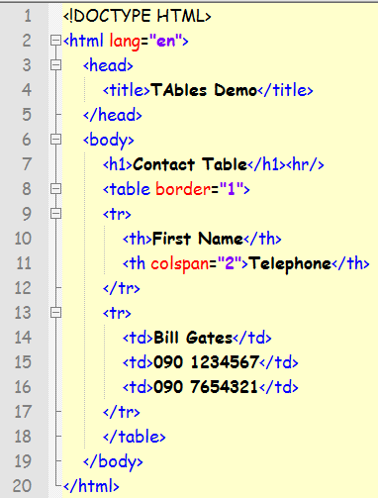
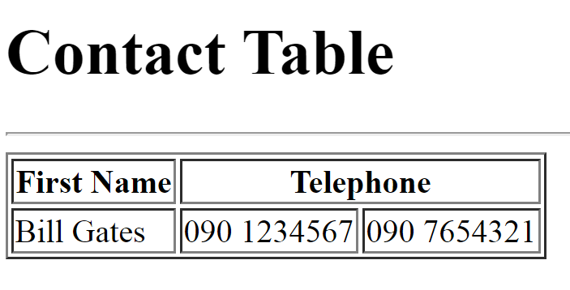
Spanning Columns

Slide 18
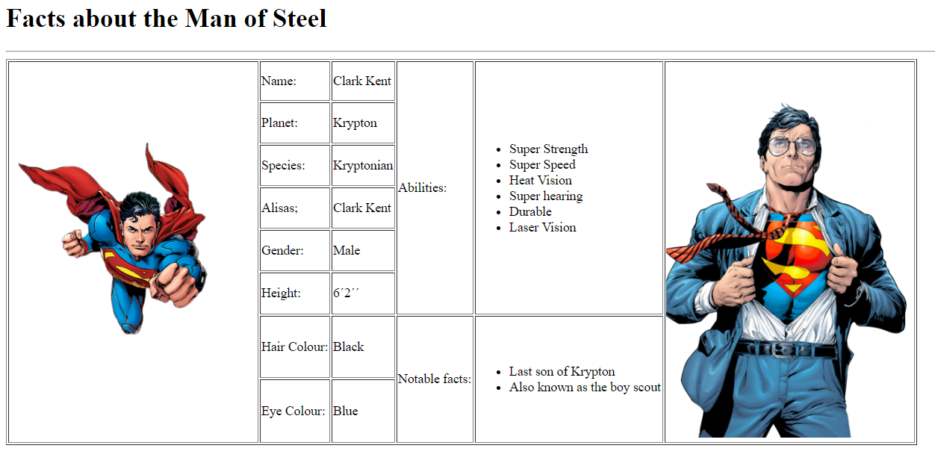
Tables Question
Using what you have learned today and the files available on Moodle create the following table on a html file called superman.html

